Slide 1

SOCIAL BOOKS
By
Awais Akbar
Karthick Pandi
Yang Wang

Slide 2
FRONT END

Slide 3
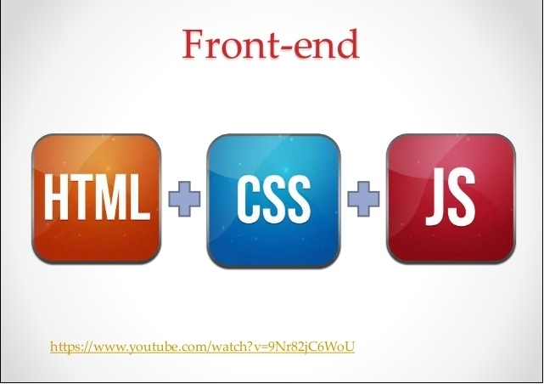

Slide 4
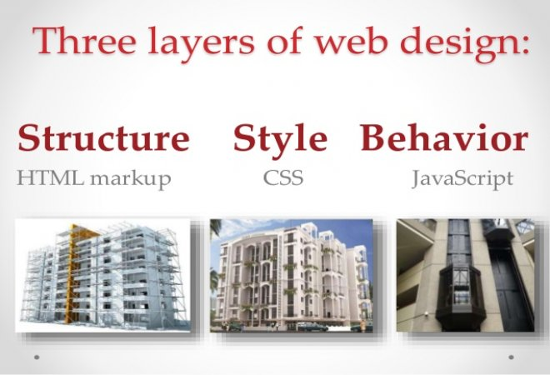

Slide 5
FRAMEWORKS

Slide 6


Slide 7
BACK END

Slide 8
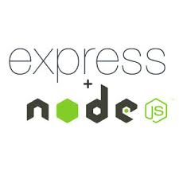

Slide 9
DATABASE

Slide 10


Slide 11
WEB HOSTING

Slide 12


Slide 13
ADVANTAGES OF USING AWS
Secure
Flexible
Reliable
Scalable
High Performance

Slide 14
REQUIREMENTS
- User Sign In and Sign UP
- Adding the books to personal library by using
. Title
. Author
. Year
. ISBN
. Abstract
. Metadata

Slide 15
REQUIREMENTS
- Search based on Metedata tags
- Books Recommendation

Slide 16
ARCHITECURE DIAGRAM

Slide 17
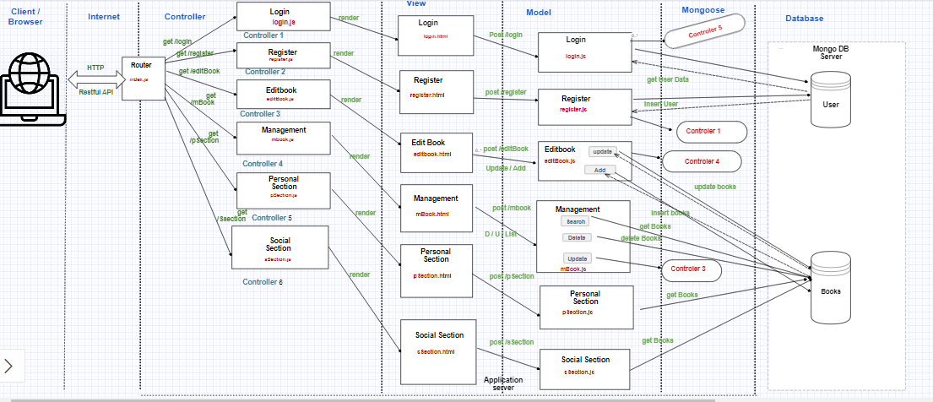

Slide 18
LOGIN PAGE
Login Page has Two Main Functionalities :
1) Login
2) Register

Slide 19
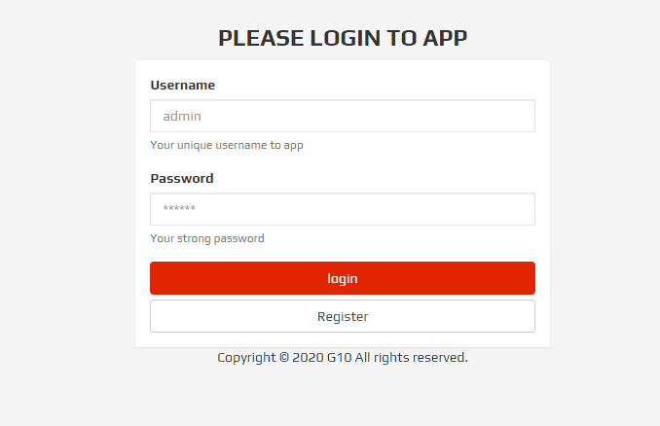
LOGIN PAGE

Slide 20
PERSONAL SECTION
Personal Section :
1) This section holds the list of books available in personal section
2) In addition to that it has customized search where we can able to search the books based on topics.

Slide 21
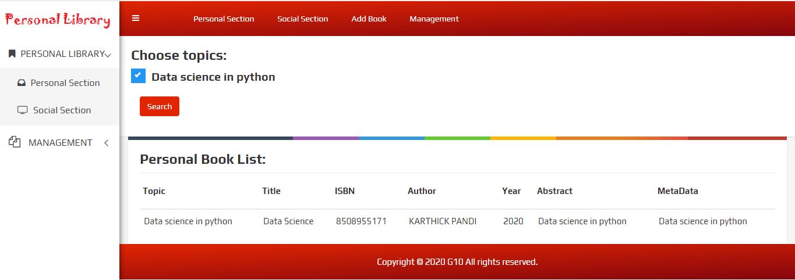
PERSONAL SECTION

Slide 22
SOCIAL SECTION
Social Section :
1) This section holds the list of books available in social section
2) In addition to that it has customized search where we can able to search the books based on topics.

Slide 23
SOCIAL SECTION
Social Section :
3) Book Recommendation:
User can able to view other user books if they share atleast three books in common.

Slide 24
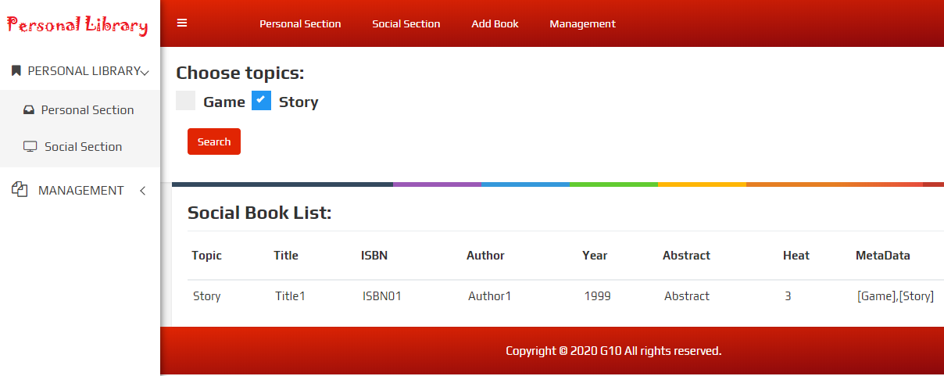
SOCIAL SECTION

Slide 25
ADD BOOK
Add Book :
1) Here we can add books to this library .The fields which required to add the books includes:
Title
Author
Public Year
ISBN
Abstract
Metadata

Slide 26
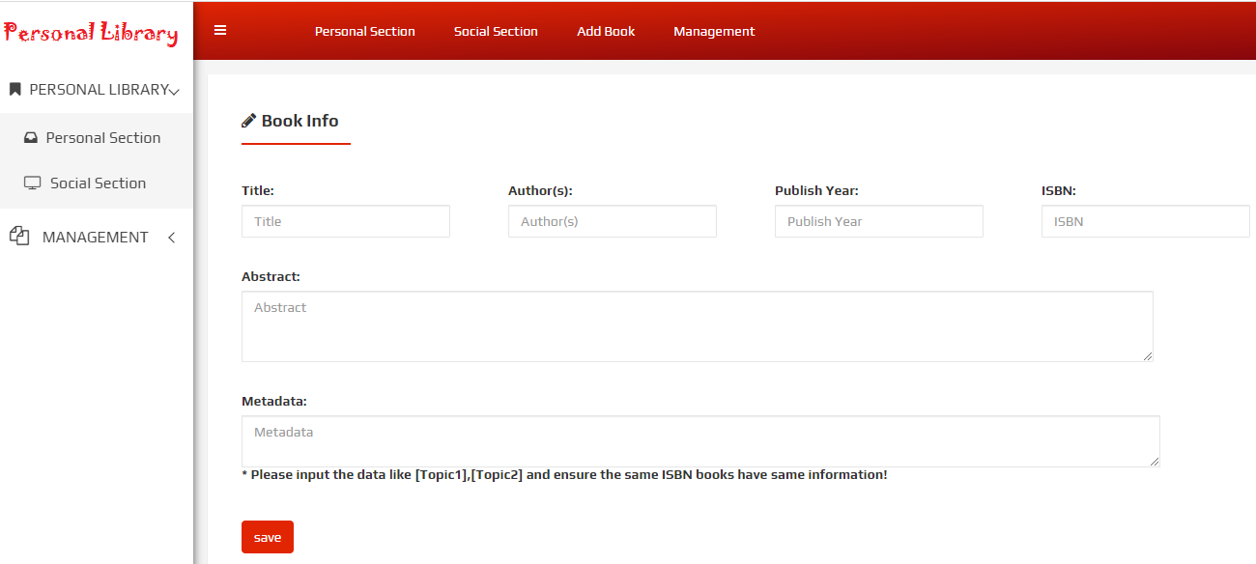
ADD BOOK

Slide 27
BOOK MANAGEMENT
Book Management :
1) Customized search based on Title,
Author Name, Published Year and ISBN

Slide 28
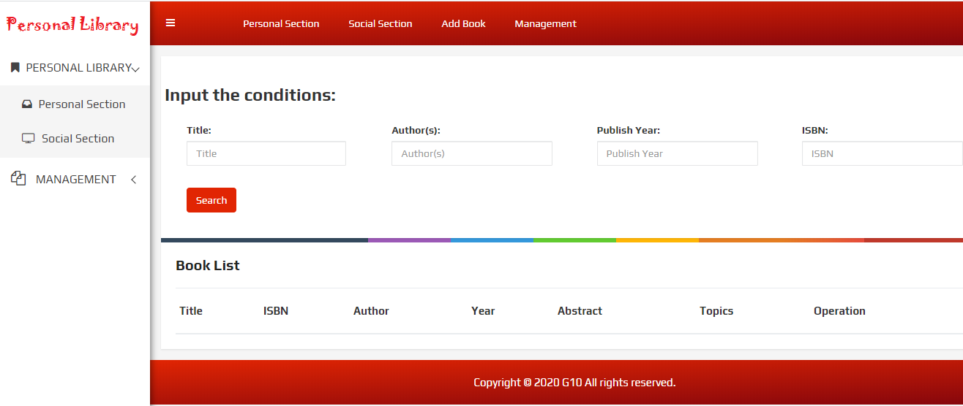
BOOK MANAGEMENT

Slide 29
APP DEPLOYMENT

Slide 30


